Slide 1

The Data Dive: Unveiling Patterns in Excelerate’s User Engagement

Slide 2
Outline
Introduction
Dashboard Overview
Key Decisions and Design Choices
Challenges Faced
Solutions Implemented
Insights Derived
Addressing Key Questions
User Interaction and Guidance
Visual Highlights
Impact on Decision-Making

Slide 3
Introduction
Excelerate is the world’s first platform for gaining 21st-century skills through personalized experiences and learnership opportunities from anywhere in the world. Team 2H presents to more insights to the Excelerate datasets.
User Data
The User Data set contains non-identifying information about users, including variables such as 'PreferredSponsors’, 'Gender’, 'Country’, 'Degree’, 'Sign Up Date’, 'City’, 'ZIP’, and 'IsFromSocialMedia’ and the dataset consists of 27,562 rows and 8 columns.
Opportunity Sign-Up and Completion Data
The Opportunity Sign-Up and Completion Data set encompasses 20322 rows and 21 columns, documenting user engagement, preferences, and achievements within Excelerate's ecosystem.

Slide 4
Dashboard Significance
Purpose:
To provide Excelerate with comprehensive insights into user participation on their platform.
Significance of the Dashboard:
Data- driven decision making
User experience enhancement
Retention Strategies
Demonstration of value

Slide 5
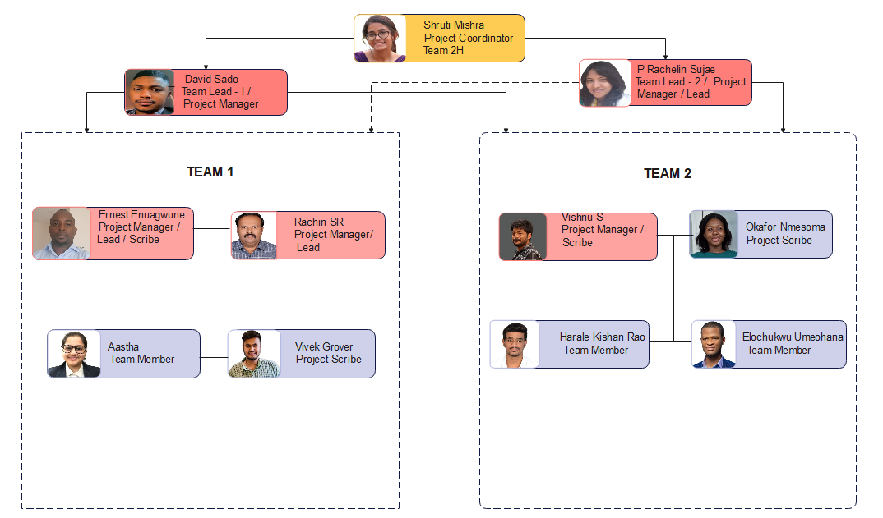
The Team

Slide 6
Dashboard Overview
Header
Logo and Title
Navigation Menu
Overview/Summary Section
Key Metrics
Time Period Selector
Charts and Graphs
Data Visualizations
Interactive Elements
4. Filters and Controls:
Filter Options
Dropdowns and Input Boxes
5. Design Choices:
Color Scheme
Consistency
Whitespace
6. Responsiveness:
Mobile Compatibility

Slide 7
Key Decisions and Design Choices
Introduction:
Choosing the right data and making thoughtful design decisions are only two of
the many decisions that go into creating a strong dashboard.
Key Decisions:
Data Cleaning
Data Preprocessing
Visualization Choices
Interactivity Features
Color Palette and Style

Slide 8
Challenges Faced
1. Handling Large Datasets
2. Visualization Challenge
3. Data Quality Issues
4. Categorical Data Handling
5. Data Transformation Techniques
6. Documentation and Interpretability
7. Deciphering Non-Identifiable User Data
8. Insights for Informed Decision-making
9. Comparative Analysis - User vs. Opportunity
Data
10. Dashboard and User Experience
11. Time Management

Slide 9
Solutions Implemented
Handling Large Dataset:
Data Filtering
Visualization Challenge:
Appropriate Visualizations
Interactivity
Data Quality Issues:
Data Validation
Establish uniform Metrics
Categorical Data Handling:
Encoding Techniques
Data Transformation Techniques:
Standardization/Normalization
Documentation and Interpretability:
Detailed Documentation
User-Friendly Documentation
7. Feature Engineering:
Domain Understanding
New Features
8. Dashboard Design and User Experience:
Best Practices
Usability Testing
9. An Acceptable Meeting Time was Planned and Agreed.

Slide 10
Insights Derived
The most compelling insights derived from the data analysis of Excelerate's User Data and Opportunity Sign-Up and Completion Data include:
Peak Period Analysis
User Demographics and Preferences
Sponsorship Strategies
Continuous Monitoring and Adaptation

Slide 11


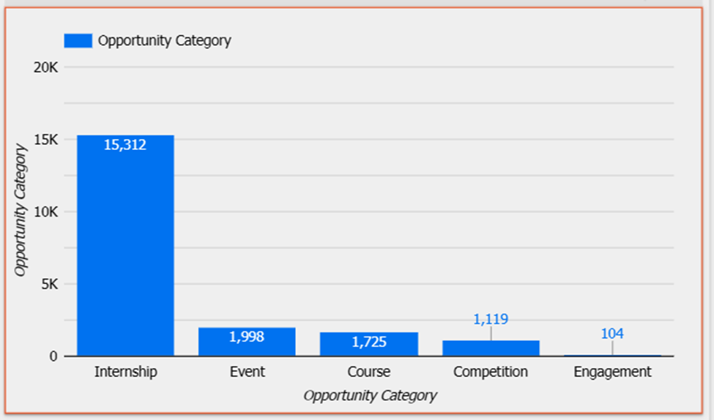
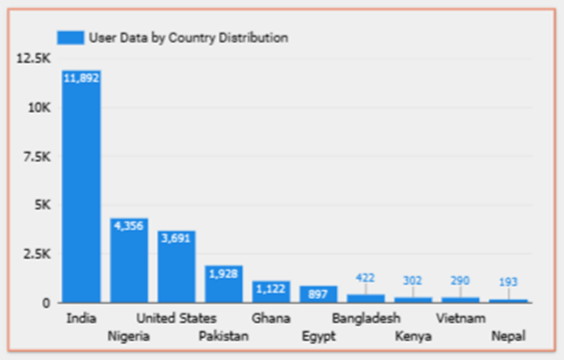
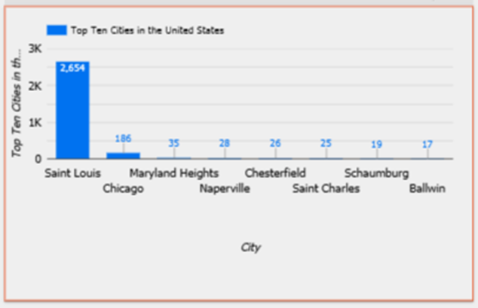
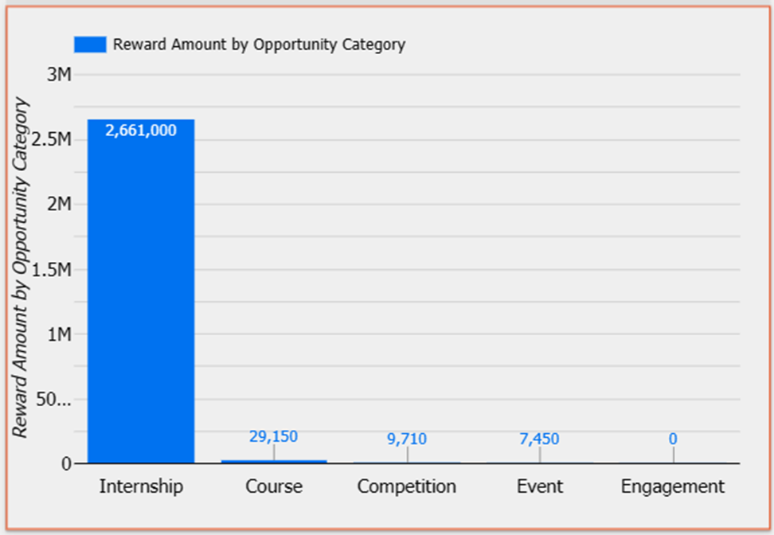
Addressing Key Questions
How many people are signed up on the platform, and how many of those have signed up for opportunities?
What are the top 10 countries learners have signed up from?
What are the cities in the US learners have signed up from?
Which is the most popular opportunity learners have signed up for?

Slide 12
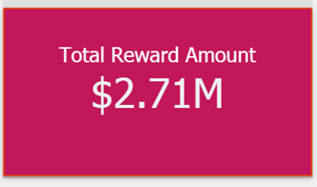
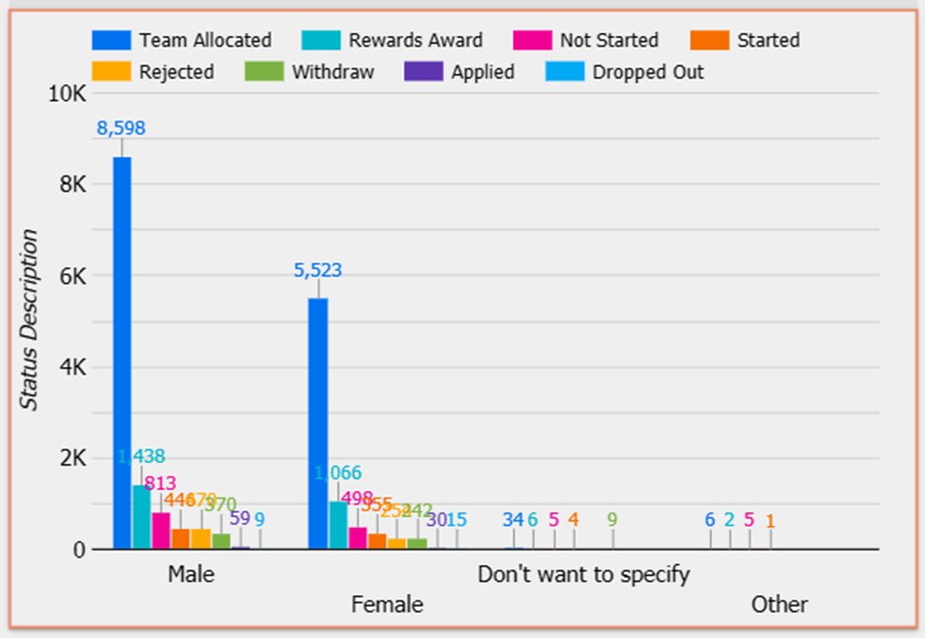
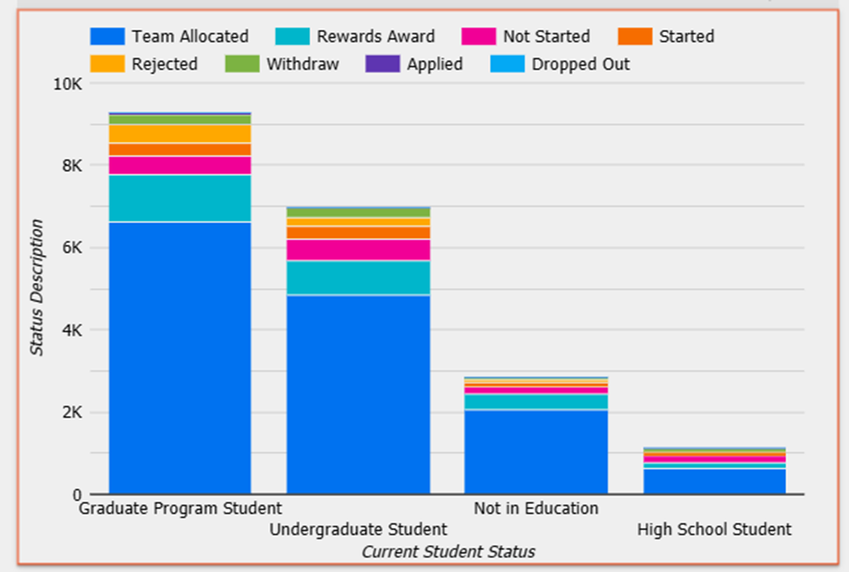
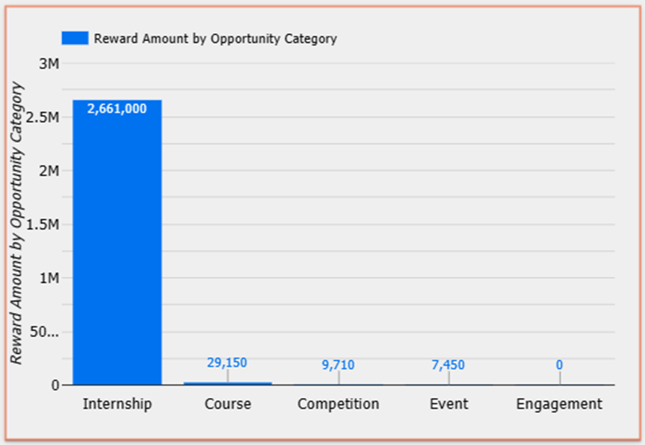
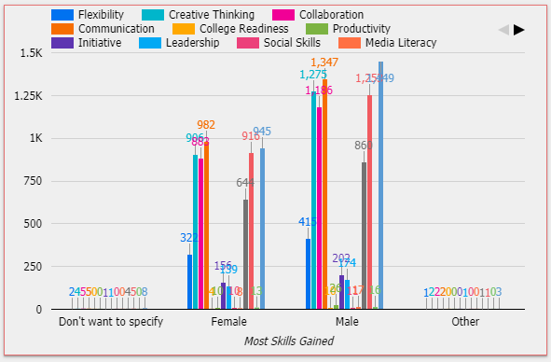
Cont…
5. Which is the most popular opportunity learners have completed?
6. What is the demographic (gender, student status, etc.) of those who have signed up and completed?
7. What are the most gained skills on Excelerate?
8. How much is the total scholarship awarded and through which opportunities?

Slide 13
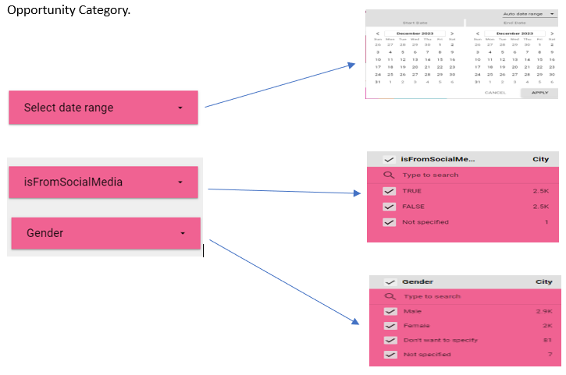
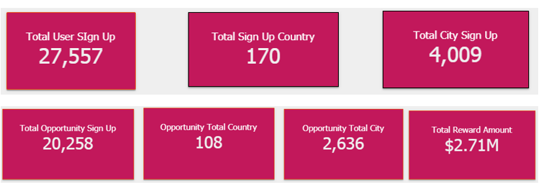
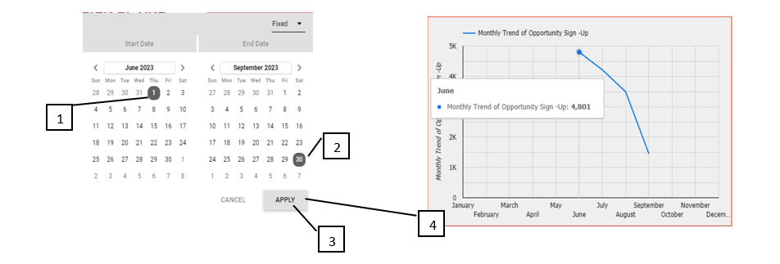
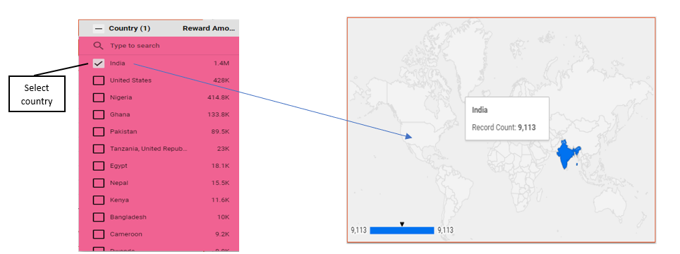
User Interaction and Guidance
A simplified dashboard with the following guidance for easy user interaction includes:
Interactive Filters
Hover-over Information
Dynamic Sign-up Trend Analysis
Region-specific Filters

Slide 14
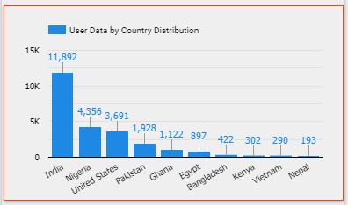

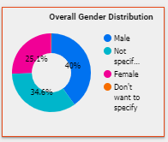
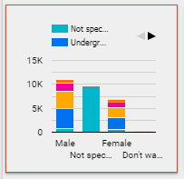
Visual Highlights: User Data
Total number of those who signed up on the Excelerate platform.​
Insight on the demographic distribution of the Users ​
India: 11892, Nigeria: 4356 and US: 3691.
​

Slide 15
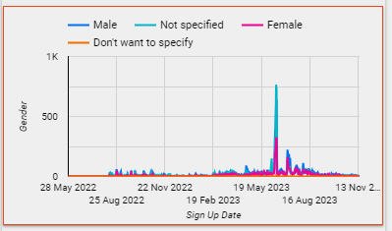
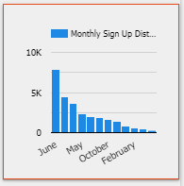
Visual Highlights: User Data
​
34.6% did not specify their gender, while 39.2% did not specify their degree level, sum up to 9,417.
Fluctuations in sign-up trend over time with the peak in June, a total of 7930.

Slide 16

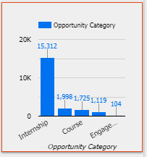
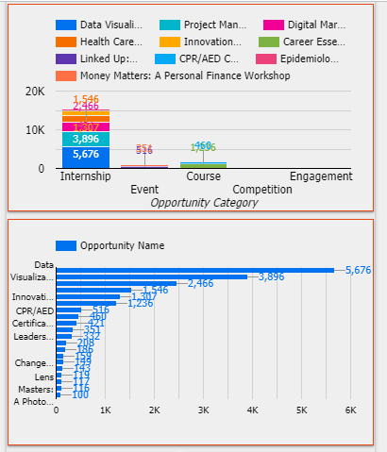
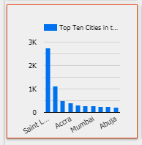
Visual Highlights: Opportunity Sign Up and Completion Data​
Total number of users who signed up for opportunities .​
India: 9113 users, US: 3856 and Nigeria: 3343 users.​
Saint Louis accounted for a record 2654, 69% of the US applicants.​
Internship the most sort after opportunity:15312.​
Data Visualization: 5676 applicants.​
Total scholarship awarded: $2.71M.

Slide 17
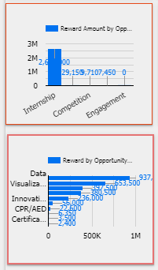
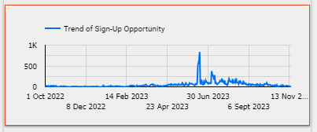
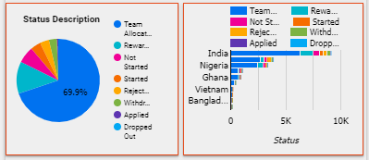
Opportunity Sign-Up and Completion Data Cont..
Opportunity sign-up trend over time fluctuated, June: 4801,
Only 12.4% completed the opportunity
Graduate program students’ completion rate compared to other student status, recorded 1142.
Nigeria completed above US
Internship has the most scholarship reward amount of $2.66M of which $937,500 was awarded to Data Visualization

Slide 18
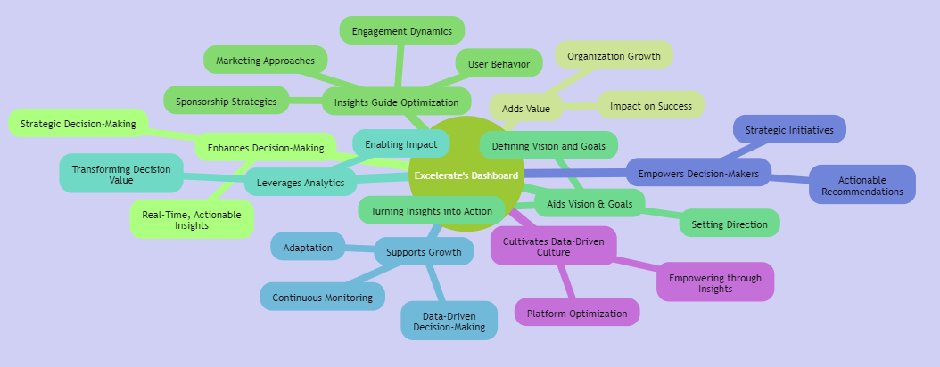
Impact on Decision-Making

Slide 19

Link to Dashboard:
https://lookerstudio.google.com/reporting/e1a5540e-a4cb-4106-a8c0-254ae28bc5b9

